Slide 1



A fun way to do your assignments!
Team: Alphaknights

Slide 2

PROBLEM
We hate doing class assignments because it had no incentive for the student other than getting good grades.
Assignments are however an important part of learning. One needs to get a sense of progress in the short-term while doing assignments for them to enjoy it.

Slide 3
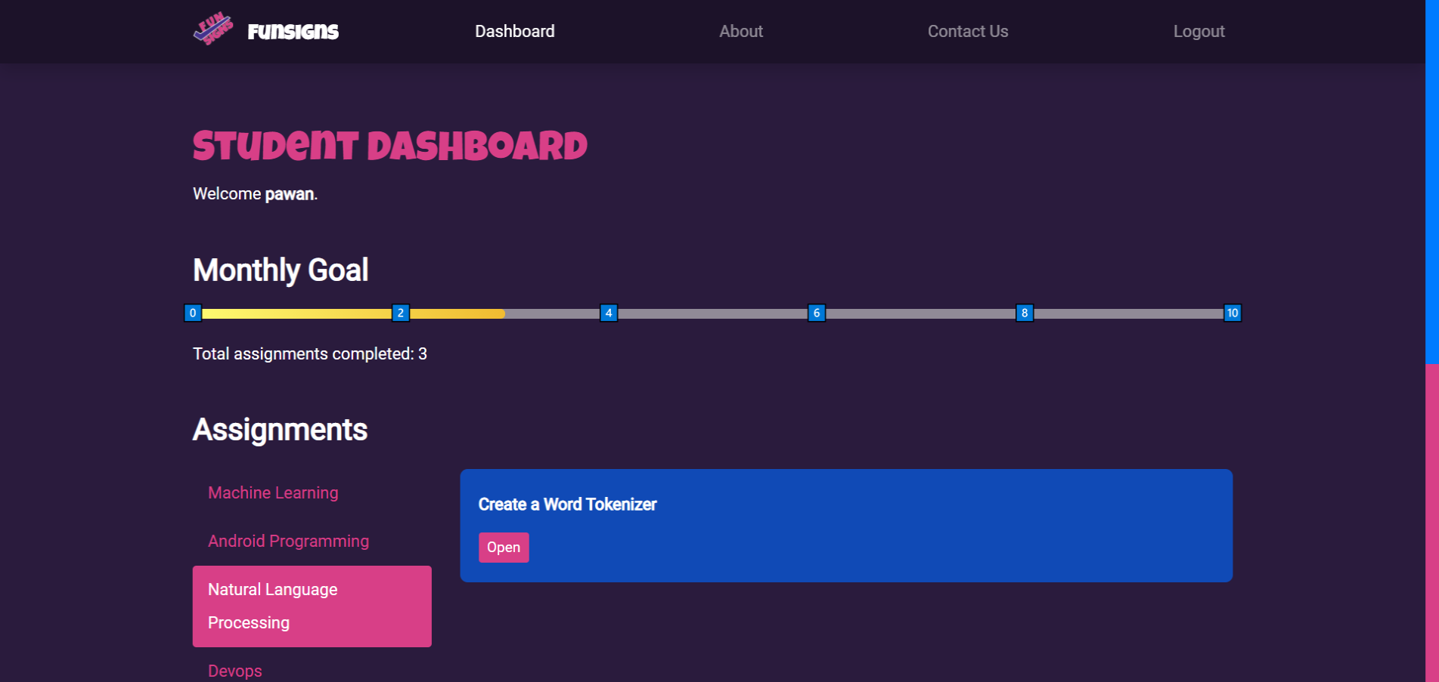

FUNSIGNS
Funsigns is a reward-based web platform where students can enjoy doing assignments while earning rewards.
We built Funsigns with elements of Gamification, so that students complete assignments as if they were levels in a video game.

Slide 4

CORE FEATURES
Login & Registration - Student and Faculty
Faculty can add courses with assignments
Students receive badges on completing assignments
Plagiarism check when submitting assignment
Progress bar for monthly assignment submission goals

Slide 5







TECHNOLOGIES
React (Frontend)
SASS (Styling)
Redux (State Management)
MongoDB (DB)
Strapi (Backend)
Heroku (Hosting Backend)
Netlify (Hosting Frontend)

Slide 6
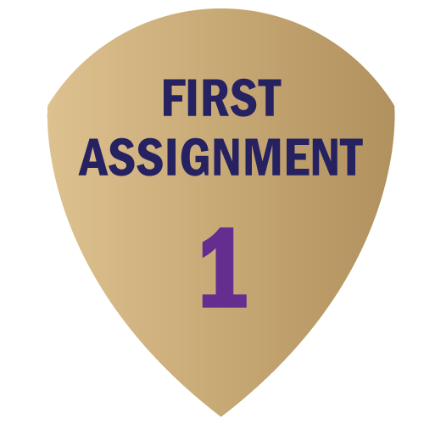

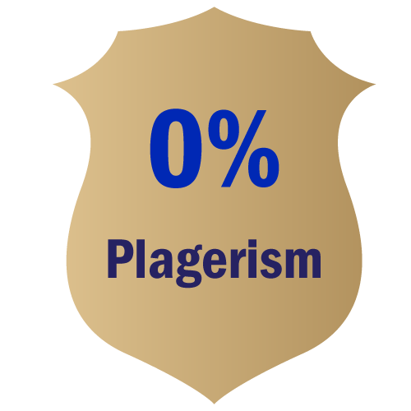
BADGES
Submitted 6 assignments in total
Submitted their first assignment
Submitted an assignment with no plagiarism

Slide 7
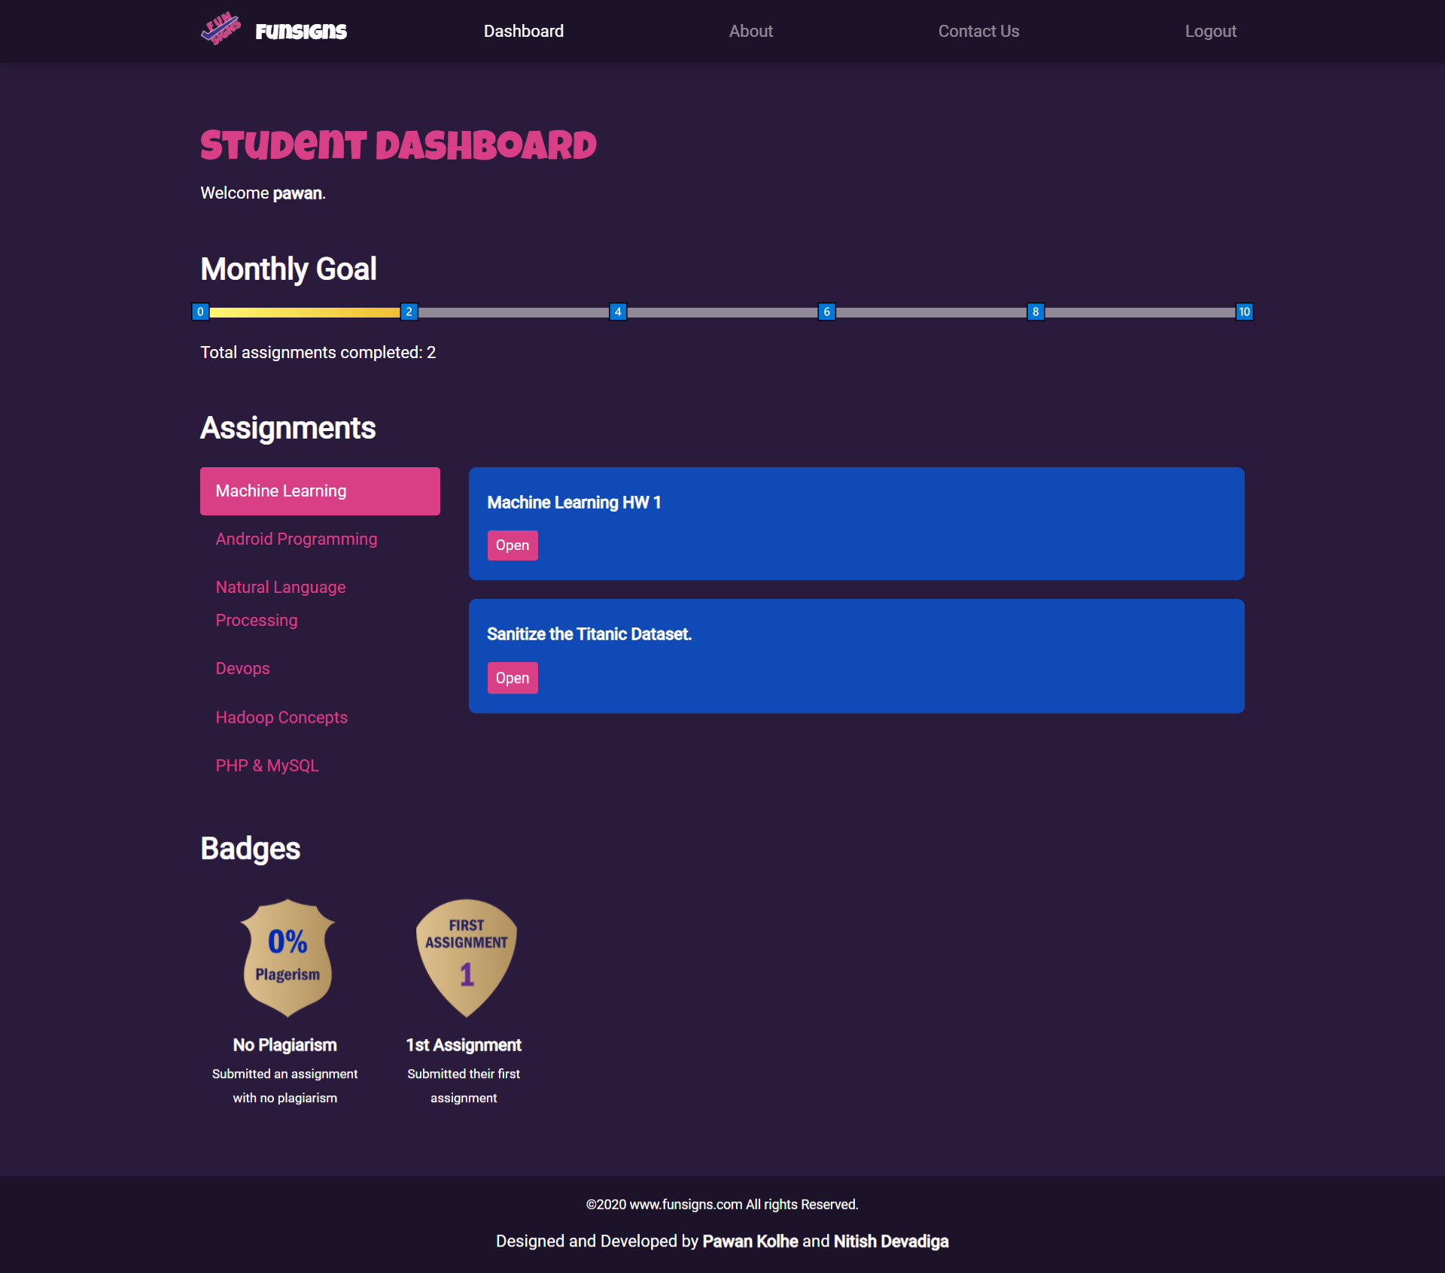
Student Dashboard

Slide 8
Student Dashboard

Slide 9
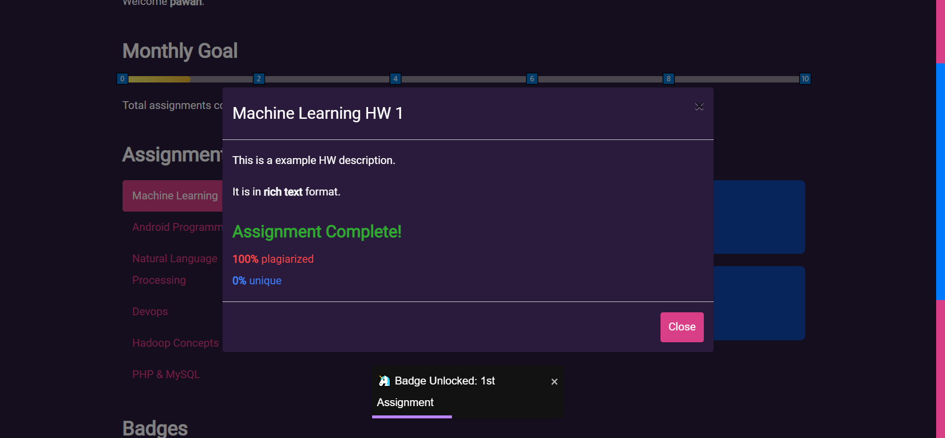
Assignment

Slide 10
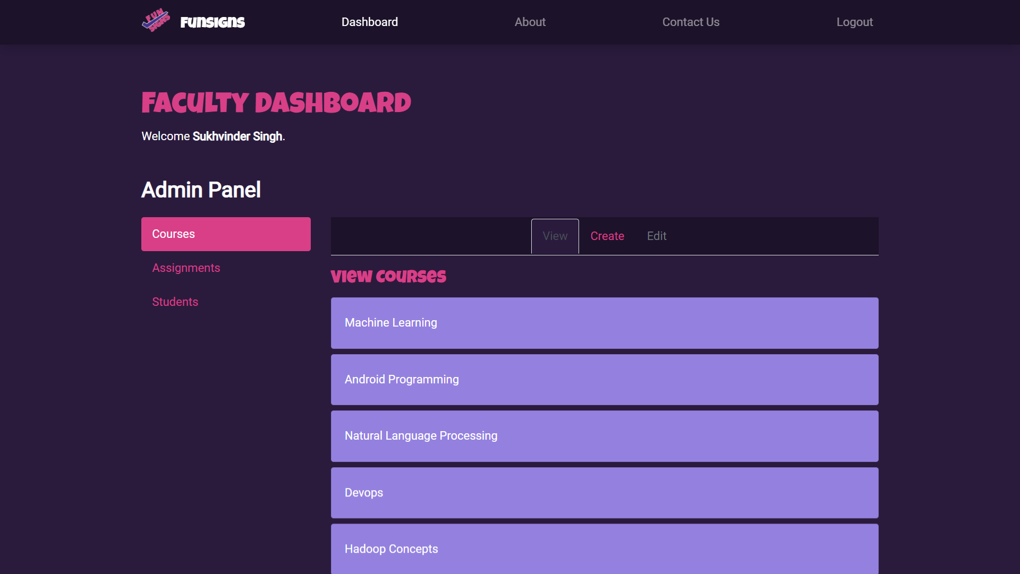
Faculty Dashboard

Slide 11
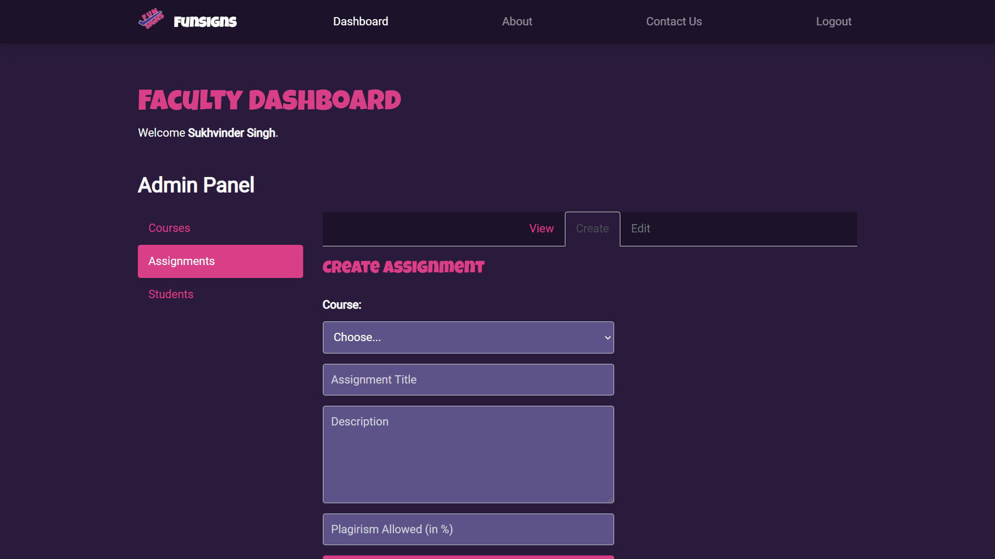
Faculty Dashboard

Slide 12



FUTURE SCOPE
Submitting ‘files’ as assignments (pdf, docx, images) which would be parsed for text in the backend and run through the plagiarism check API check if submission satisfies the minimum plagiarism criteria for the assignment.
Student could earn points for submitting each assignment and redeem accumulated points for a reward from a marketplace.
Sending direct messages to faculty for feedback and questions.

Slide 13



FUTURE SCOPE
Faculty could track student assignments to gain insight into plagiarism of assignments
Graphs for visualizing performance of students
Marketplace for redeeming points earned

Slide 14
Thanks!
Presentation by Alphaknights
(Pawan Kolhe & Nitish Devadiga)

